Slide 1
Software is Energy Lean software for Green Computing
maurizio.morisio@polito.it
Notes:
Giocare sul ?

Slide 2

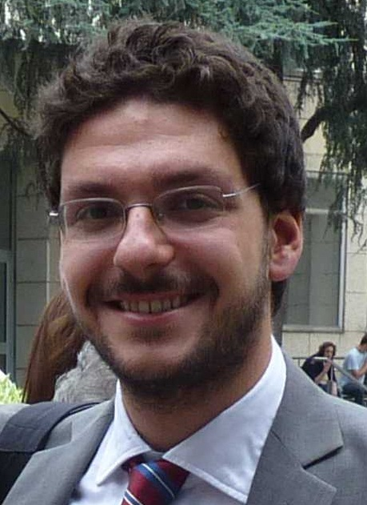

Kudos
Luca Ardito
Giuseppe Procaccianti
Antonio Vetrò

Slide 3



Slide 4

Outline
Roadmap
Concepts
Facts
Guidelines
Roadmap
Labels
Essentials
Guidelines
Facts
Concepts

Slide 5

Concepts

Slide 6
Green what?
Software product
Greening software (ICT)
Software process
System
Embedded Software product
Greening the process
Greening by
Software (by ICT)
Notes:
Options: green the process (not much leverage)
green the sw product
green the system

Slide 7
Effects
Software product
First order
Software process
Socio technical System
System
Embedded Software product
Second order
Third order
Notes:
Ex first order. Hardware consumes less, because of better algorithm
Ex of second order. Car consumes less fuel, thanks to better routing (ICT) or better negine management
remark, sw can be ineffcientt bu tsystem more efficient
Ex of third order. People use car less because of ICT devices that show consumptions / emissions

Slide 8
Greening ‘by’ software
Smart grids
Smart cities
Smart cars
Smart factories
Smart ..

Slide 9

Greening ‘by’ software
The world is my energy oyster
Notes:
The world is my oyster (enjoy the world – the world is the limit to green by sw)

Slide 10
Greening ‘the’ software
deployment
dismissal
development
operation
maintenance
Green the process
(LEAN and GREEN)
zero order effect
Green the software
First order effect
Notes:
Paper su distribuz TCO per PC? Qui operation conta poco

Slide 11

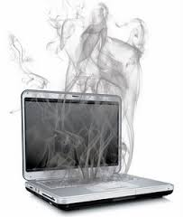
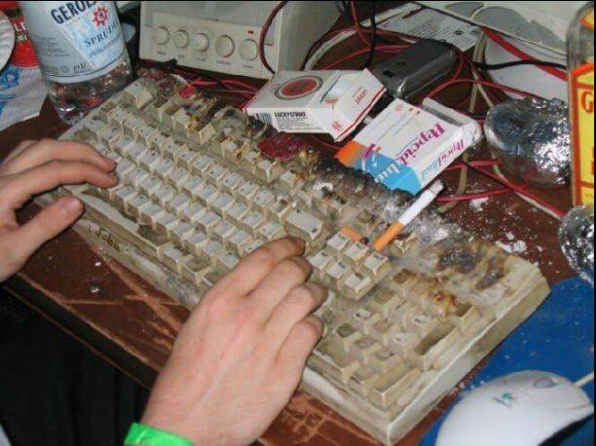

Slide 12
Green, what?
What does software mean exactly?
Energy Consumption / Waste / Gas emissions
ISO 14040, LCA
Sustainability
ISO 25010 (was ISO 9126) extended

Slide 13
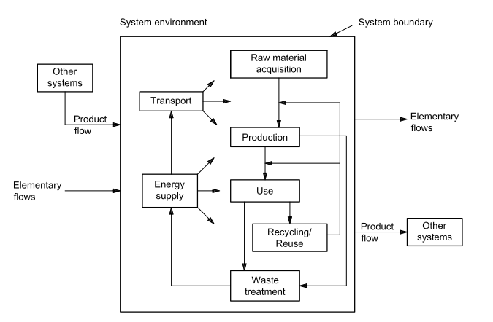
Life Cycle Assessment – ISO 14040
Notes:
Flows: energy, water, gas emissions, wastes, raw materials
Sort of TCO for energy
In cars, well to wheel
Example of electric cars

Slide 14
LCA
Flows
Energy
Gas emissions
(raw materials and wastes)

Slide 15
Sustainability
“meeting the needs of the present without compromising the ability of future generations to meet their own needs” [UN report]
Dimensions
Economic
Social
Environmental
Technical
(Human)
Notes:
United Nations. Report: Our Common Future. In Conference on Environment and Development, 1987.

Slide 16
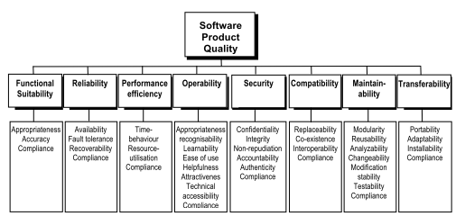
ISO 25010
Energy efficiency
Notes:
Ardito L., Procaccianti G., Vetro' A., Morisio M. Introducing Energy Efficiency into SQALE in ENERGY 2013, The Third International Conference on Smart Grids, Green Communications and IT Energy-aware Technologies

Slide 17
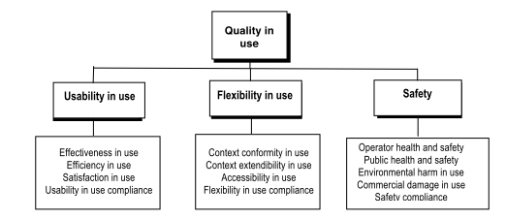
ISO 25010
Sustainability
In use
Energy consumption
Energy efficiency
Pollutant emissions

Slide 18
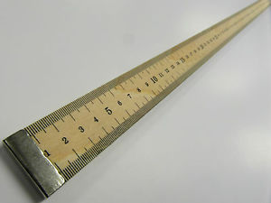
Metrics
Sustainability
Environmental dimension
Energy [Joule]
Power [Watt]
Efficiency: useful energy / total energy
Productivity: computational work / energy

Slide 19

Metrics
NODE
NETWORK
INFRASTRUCTURE
Notes:
Ardito L., Morisio M. Green IT - available data and guidelines for reducing energy consumption in IT Systems SUSTAINABLE COMPUTING, Vol.4, pp.24-32, ISSN:2210-5379

Slide 20

Node
Application
OS
Hardware

Slide 21
Metrics – node level
Power, Energy:
Watt, Joule
Productivity:
MFLOPS / Watt
Power (node/application):
power used by application
Productivity (node/application):
sorted records / Joule
Power (node/OS):
power used by OS

Slide 22
Metrics - network
Efficiency (network):
energy(full - idle)/energy(full)
Productivity(network):
KB transferred / Joule

Slide 23
Metrics – infrastructure level
Productivity (data center):
useful work / energy
Efficiency (data center):
power used for storage /total power used

Slide 24
Summary
(Zero), first, second, third level effects
Green? Sustainable?
No established general model
Suggestion, first level
25010 extended with sustainability in use,
metrics like energy, power, efficiency, productivity
At node/network/infrastructure level
LCA to be included
Assumption: operation phase counts most

Slide 25
Outline
Concepts
Facts
Guidelines
Roadmap
Labels
Essentials
Facts
Concepts

Slide 26
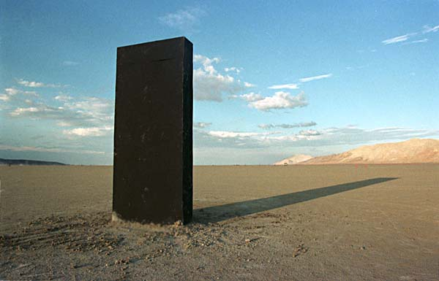
Facts

Slide 27
Energy consumption (2007)
TOTAL: 144000 TWh

Slide 28
Energy consumption (2007)
Software product
1% total E (14000 TWh)
5% total EE (17400 TWh)
First order
Socio technical System
System
Embedded Software product
Second order
Third order
Notes:
J. Bogdanovic, C. Heberlein, O. Simonett, and C. Stuhlberger “Kick the Habit: A UN Guide to Climate Neutrality,” PROGRESS PRESS LTD MALTA, 2008.
M. Webb, E. Al., Smart 2020: Enabling the low carbon economy in the
information age, The Climate Group London (2008).

Slide 29
Energy consumption within ICT
Notes:
Focus on data centers, but not only

Slide 30
CO₂ emissions
Software product
2% total emissions
First order
Socio technical System
System
Embedded Software product
Second order
Third order
Notes:
J. Bogdanovic, C. Heberlein, O. Simonett, and C. Stuhlberger “Kick the Habit: A UN Guide to Climate Neutrality,” PROGRESS PRESS LTD MALTA, 2008.
M. Webb, E. Al., Smart 2020: Enabling the low carbon economy in the
information age, The Climate Group London (2008).

Slide 31
CO2 emissions, ICT

Slide 32
Lifecycle analysis - PC
Notes:
E. Williams, Energy intensity of computer manufacturing: hybrid as-
sessment combining process and economic input-output methods., En-
vironmental science technology 38 (2004) 6166{6174.
[32] V. G. Moshnyaga, A new approach for energy management in user-
centric applications, in: Proceedings of the International Conference on
Green Computing, GREENCOMP '10, IEEE Computer Society, Wash-
ington, DC, USA, 2010, pp. 107{112.

Slide 33
Energy– data centers
Notes:
V. G. Moshnyaga, Integrated circuit and system design. power and
timing modeling, optimization and simulation, 2009, pp. 82{92.

Slide 34
ICT footprint
Small in %
Big in absolute numbers
Increasing trend
Worthwhile to work for reducing it

Slide 35
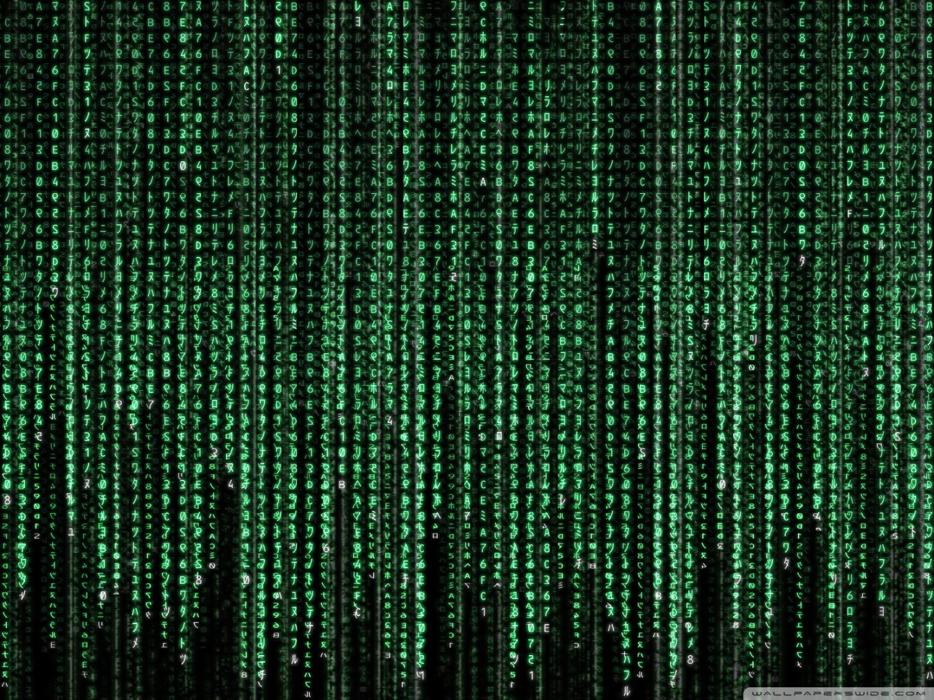
Software is energy?

Slide 36
Software is energy?

Slide 37
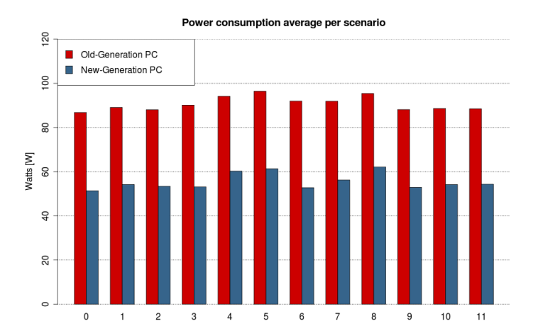
idle
Email
P2P
Web nav
Disk access
Skype call
Video play
USB access
Audio play
Product suite
Image browsing
Skype call video
Notes:
10 20 % (+10W 50 to 60 blue, 86 96 red)
Procaccianti G., Ardito L., Vetrò A., Morisio M. (2012)

Slide 38
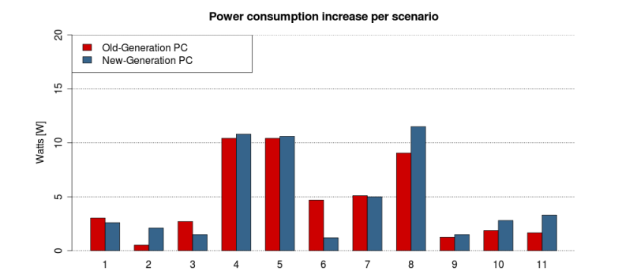
P2P
Email
Web nav
USB access
Skype call
Video play
Disk access
Audio play
Product suite
Image browsing
Skype call video

Slide 39
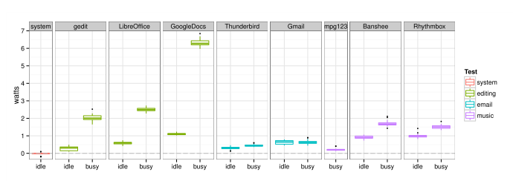
PC, application families
Notes:
The Impact of User Choice on Energy Consumption
Chenlei Zhang, Abram Hindle
Daniel M. German

Slide 40
Issues
Definition of scenarios of usage
Measurement and effect of context
(In)dependence of hardware
(In)dependence of other applications

Slide 41
Summary
Small % consumption of ICT, but huge in absolute number, and increasing
Servers first, then PCs, mobile phones
In lifecycle, manufacturing matters more
Application consumption can be measured, and has impact

Slide 42
Outline
Concepts
Facts
Guidelines
Roadmap
Labels
Essentials
Guidelines
Facts
Concepts

Slide 43
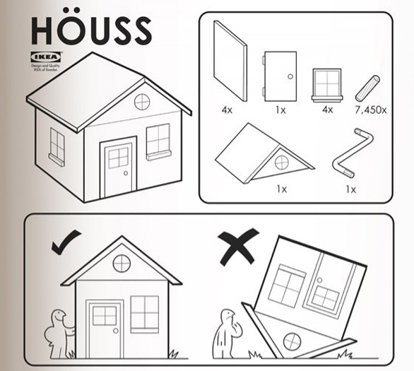
Guidelines

Slide 44
Guidelines
NODE
NETWORK
INFRASTRUCTURE

Slide 45
Guidelines – node /application level
Efficient UI design
To minimize time (energy) to accomplish a task
Event based programming
No polling, no idle resources
Low level programming
Virtual machines, high level programming may be energy inefficient
Batch I/O
Economy of scale. OS can power down IO devices when not used

Slide 46
Guidelines – Node/ application level
Allocate data / computation where more energy efficient
Cfr deploy on cloud
Data redundancy and migration
May reduce energy efficiency
Adapt/ scale QoS to energy availability
Use energy models
To adapt / optimize behavior of application

Slide 47
Guidelines – Node/OS level
Provide energy management services / API
Cfr energy models for applications
Optimize use of devices
Require collaboration from device drivers / device manufacturers
Use compiler optimization
Use only required services and background processes

Slide 48
Guidelines – Node/ hardware level
Power down / optimize use of peripherals
Use special purpose hardware
Use dynamic power management capabilities
ACPI
Devices provide energy consumption data
Notes:
Advanced Configuration and Power Interface (ACPI)

Slide 49
Guidelines – network level
Lower data traffic
Optimize protocols on energy consumption

Slide 50
Guidelines – infrastructure level
Deploy applications on the cloud
Virtualization, less hardware, less consumption
Worse response times
Load balancing
Distribute load on resources (CPU, storage ..)
Less powerful hardware needed
Make information about consumption available
For adapting energy behaviour

Slide 51
Guidelines - summary
Adaptation
feedback loops on energy /power
availability of energy information
models for energy behavior
scenarios of energy usage
Works already at OS – device level, to be extended upwards
System thinking
Allocation of data/computation in function of (system) energy consumption

Slide 52
Outline
Roadmap
Concepts
Facts
Guidelines
Roadmap
Labels
Essentials
Guidelines
Facts
Concepts

Slide 53

Roadmap

Slide 54
Research goals
Concepts
Greening software or by software???
Agreed upon high level model (25010 ..)
Facts
Productivity and efficiency figures
Application level
Guidelines
More detailed
With context (AKA patterns and antipatterns)
With quantified effects

Slide 55
Research goals
Guidelines
Availability of energy / power / usage information at all levels
Hardware, OS, application, function
Definition and validation of energy models at all levels
Self adaptation, at all levels
System level, layered
Benchmarking

Slide 56
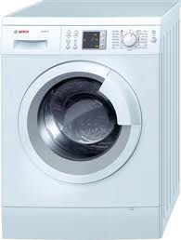
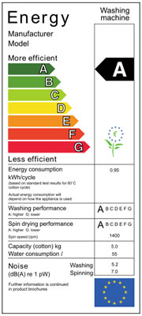
Figura label lavatrice

Slide 57
Software Energy Labels
A
benchmark
application
class
B
C
D
scenarios
Measurement standards

Slide 58
Software Energy Labels
assess
application
class
refactor
guidelines

Slide 59
Well..
Interest in domain is raising
Workshops, journals..
‘Greenness’ as (yet another) NF requirement (aka safety security) probably to stay
Lot of work to be done..
Define guidelines (good practices for software energy efficiency)
Quantify actions (guidelines) in terms of results
Trace energy efficiency to process / product

Slide 60

Have an energy (and brain) efficient workshop

